Slide 1

“Bitdefender is a global IT security technology company”
Florin Talpeș – Bitdefender CEO & Founder

Slide 2
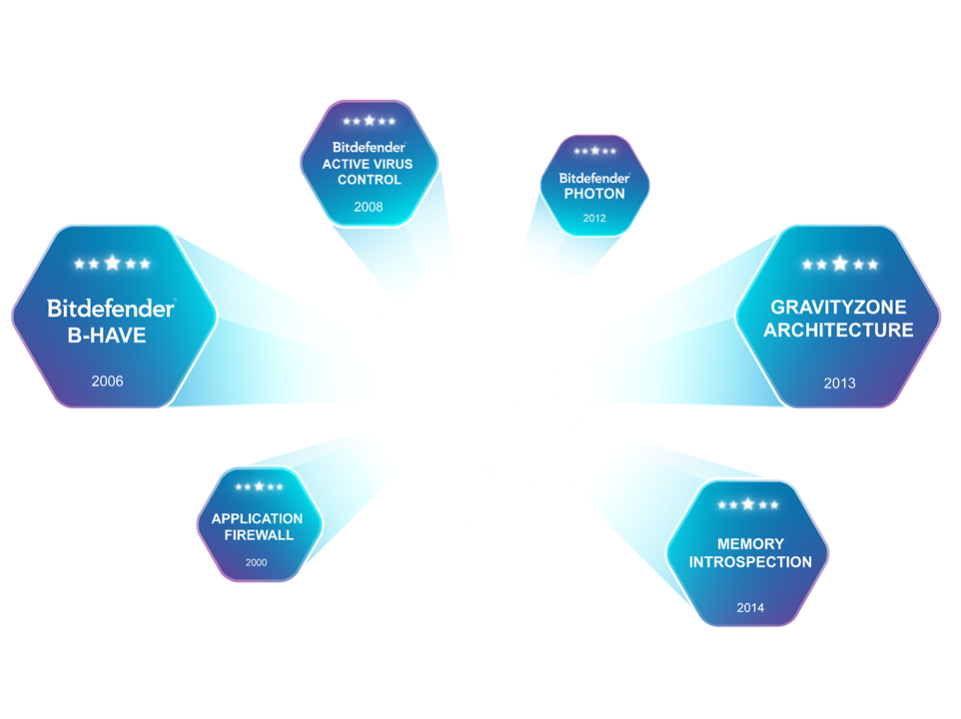

WHO IS BITDEFENDER
Notes:
Cutting edge technology (establish credibility)
OEM space provides us information from more than ½ a billion endpoints (500.000)
(almost 3x more endpoints than any other)
This information helps us to protect against current and future threats by analyzing behavior patterns.
Our primary goal has been on Virtual infrastructure as this is the direction the market is heading.
It is our mission, to use our knowledge, in order to keep bad guys out of your business.
Cybercriminals are targeting datacenters (linux and webservers) more and more.
An infected webserver can then spread the infection to many unaware users.
Huge amounts of data collected and stored is an opportunity waiting for a hacker.
Once security has been breached the data could be sold to the highest bidder…
This threat is real, however there are steps that can be taken to be better prepared…
…and this is without eating all your resources and time!

Slide 3
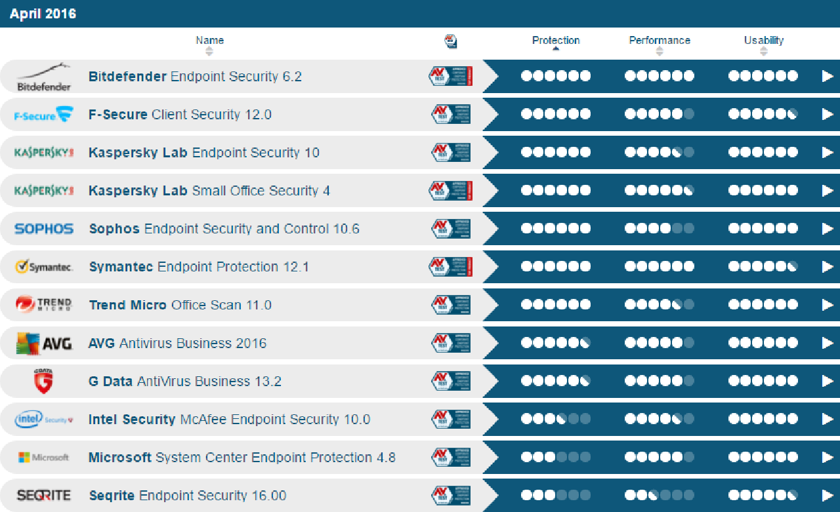
CONSISTENTLY IN TOP
https://www.av-test.org/en/antivirus/business-windows-client/

Slide 4
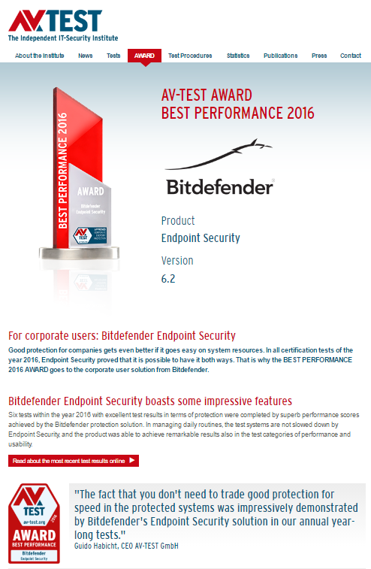
AV-TEST AWARD
BEST PERFORMANCE 2014, 2015, 2016
Per gli anni 2014, 2015 e 2016
AV-Test riconosce a Bitdefender
il Best Performance Award
per le sue soluzioni di Enpoint Security.
Questo riconoscimento
testimonia la qualità delle tecnologie Bitdefender,
che offrono costantemente
massima protezione con il minor impatto possibile
sulla operatività degli utenti.
Notes:
Overview is important
I mean, how do you know that you have been hacked?
A good place to start is endpoints, all your endpoints!
Èn konsol der hjælper med dette…
• Virtuelle maskiner
• Fysiske maskiner
• Mobile enheder
• Exchange
…kommer både som CLOUD og ON-PREMISE!

Slide 5

PROTECTING 500 MILLION USERS WORLDWIDE
Notes:
Overview is important
I mean, how do you know that you have been hacked?
A good place to start is endpoints, all your endpoints!
Èn konsol der hjælper med dette…
• Virtuelle maskiner
• Fysiske maskiner
• Mobile enheder
• Exchange
…kommer både som CLOUD og ON-PREMISE!

Slide 6
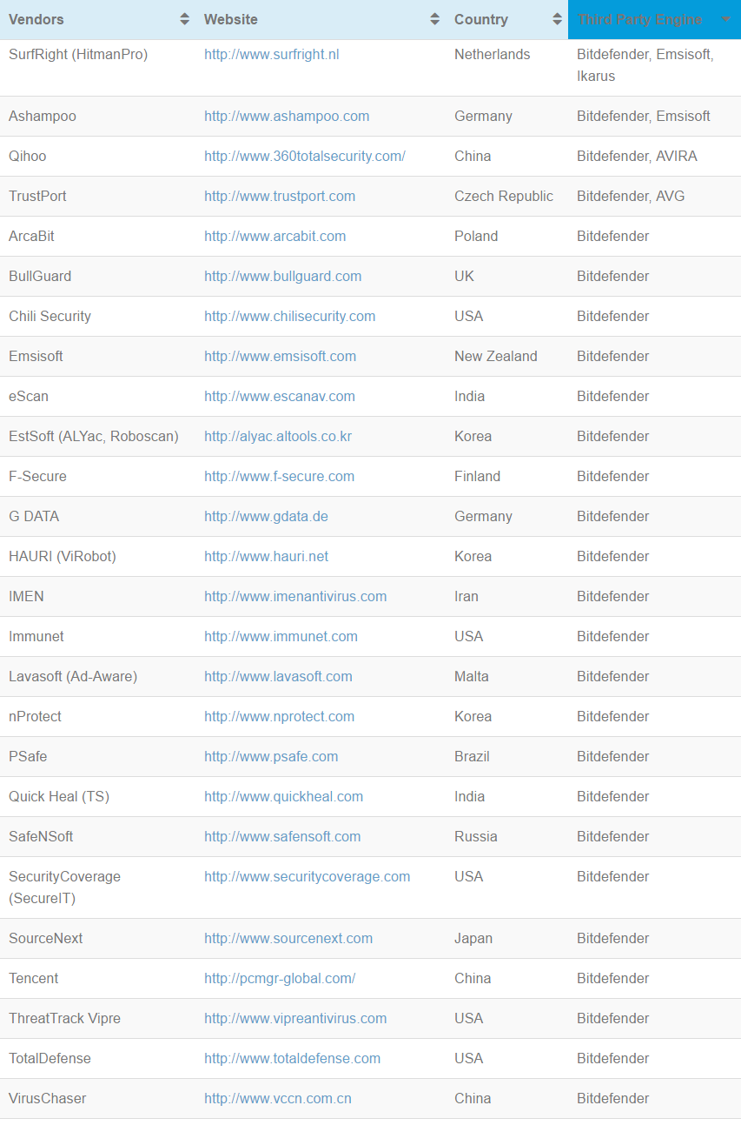
OEM PARTNERS

Slide 7
L’OFFERTA COMMERCIALE

Slide 8
CONSUMER vs BUSINESS
Differenziale | CONSUMER | BUSINESS
Numero dispositivi | max 10 | da 1 a illimitati
Protezione server | NO | SI
Protezione ambienti virtuali | NO | SI
Gestione centralizzata | NO | SI
Push rinnovo diretto su EU | SI | NO
Promozioni dirette su EU | SI | NO
Protezione rinnovo | NO | SI
Installazione | self-service | self-service o gestita
Gestione | self-service | self-service o gestita
Monthly Subscription | NO | SI
Le soluzioni consumer sono progettate per il rapporto diretto fra utente finale e vendor.
Non contemplano accorgimenti per veicolare e tutelare il ruolo del canale.

Slide 9

CONSUMER PORTFOLIO
2017 | Antivirus Plus | Internet Security | Total Security Multi-Device
Piattaforme | Windows PC | Windows PC | Windows PC, Mac OS, Android
Antimalware MIGLIORATO | X | X | X
Navigazione Sicura | X | X | X
Anti Ransomware NUOVO | X | X | X
WiFi Security Advisor NUOVO | X | X | X
Protezione Banking Online | X | X | X
Gestore Password | X | X | X
Ricerca Sicura | X | X | X
Antiphishing & Antifrode | X | X | X
Scansione Vulnerabilità | X | X | X
AntiSpam |  | X | X
Firewall |  | X | X
Distruttore File |  | X | X
Crittografia File |  | X | X
Controllo Genitori |  | X | X
Antifurto |  |  | X
OneClick Optimizer |  |  | X

Slide 10

BUSINESS PORTFOLIO
FEATURES
Bitdefender GRAVITYZONE | Cloud Security for MSP | Business Security | Advanced Business Security | Enterprise Security
Physical Desktops | X | X | X | X
Physical Servers | X | X | X | X
Virtual Desktops | X | X | X | X
Virtual Servers | X | X | X | X
Microsoft Exchange | X |  | X | X
Mobile Devices |  |  | X * OnPremise Only | X
Central Scan |  |  | X | X
AWS deploy |  |  | X
App. Whitelisting |  |  |  | X
Data Center Licensing |  |  |  | X
Console Options | Cloud | Cloud / On-Premise | Cloud / On-Premise | On-Premise

Slide 11
BUSINESS PORTFOLIO
LICENSING
Bitdefender GRAVITYZONE | Cloud Security for MSP | Business Security | Advanced Business Security | Enterprise Security
Licensing Model | Pay per Use / Monthly | License Prepaid Yearly | License Prepaid Yearly | License Prepaid Yearly
Licensed To | MSP | End User | End User | End User
Licensed Per | Enpoint Mailbox | Enpoint | Enpoint | Enpoint Mailbox CPU
License Key | N.A. | Single | Single | Multiple (x device type)
Min. Licensed Units | 1 | 3 | 5 | 1
Max. Server | N.A. | 30 % | 35 % | N.A.

Slide 12
BITDEFENDER GRAVITYZONE
Notes:
GravityZone is a business security solution built from the ground up for virtualization and cloud to deliver business security services to physical endpoints, mobile devices, virtual machine in private, public cloud and Exchange mail servers.
Learn during this training about the GravityZone components and security services, how to install and configure them.

Slide 13
GravityZone
Architecture
GravityZone Enterprise Security architecture includes
1 management component and 4 Security Services:
Control Center
Security for Endpoints
Security for Virtualized Environments
Security for Mobile Devices
Security for Exchange
Security Services
Notes:
The GravityZone architecture includes 5 main components; a management component known as the Control Center, and 4 security services: Security for Endpoints, Security for Virtualized Environments, Security for Mobile Devices and Security for Exchange.

Slide 14
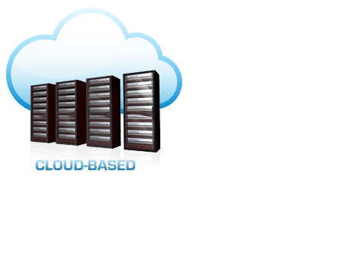
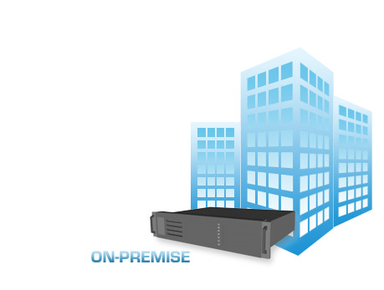
CLOUD-BASED OR ON-PREMISE
No HW requirements
Get started right away
Monthly licensing for MSPs
Minimum administration
AD integration
ESX/XEN integration
Security for Mobile
Syslog/SNMP

Slide 15

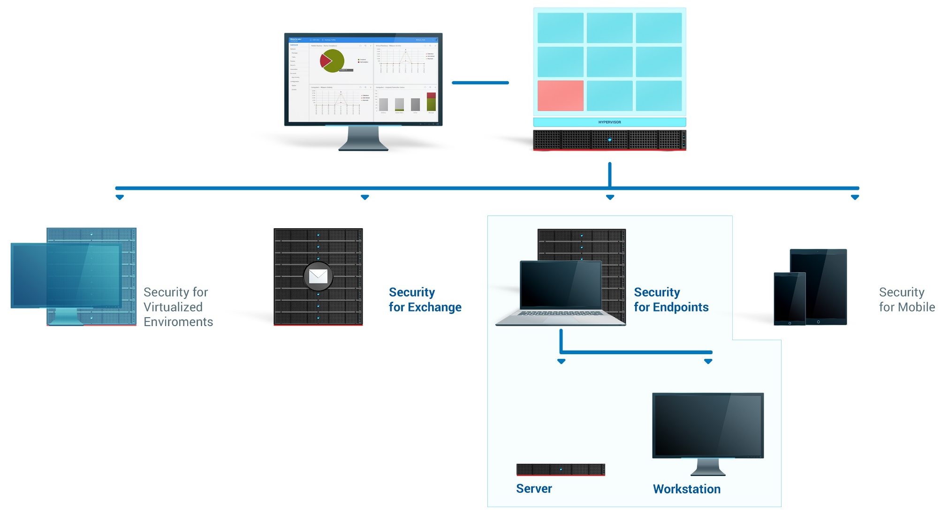
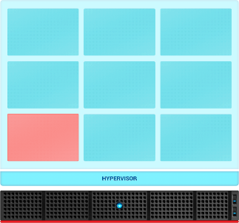
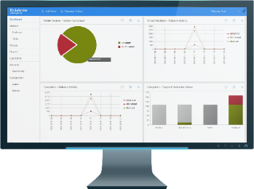
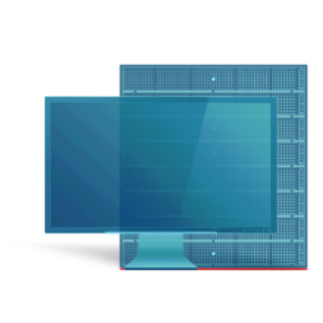
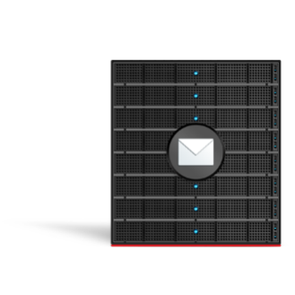
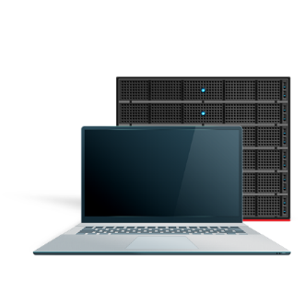
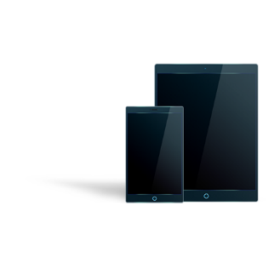

SECURITY FOR EVERYTHING
Notes:
Overview is important
I mean, how do you know that you have been hacked?
A good place to start is endpoints, all your endpoints!
Èn konsol der hjælper med dette…
• Virtuelle maskiner
• Fysiske maskiner
• Mobile enheder
• Exchange
…kommer både som CLOUD og ON-PREMISE!

Slide 16





OS SUPPORT
Notes:
OS support
…its worth mentioning that all operating systems are supported to further help in providing full vissibility of the infrastructure!

Slide 17




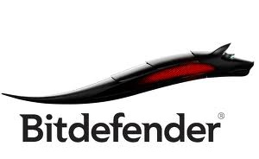




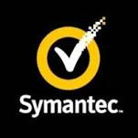
UNINSTALL EXISTING AV
Notes:
Afinstallation af eksisterende AV
Bitdefender makes life easier by automatically detecting and uninstalling the most popular AV products.

Slide 18
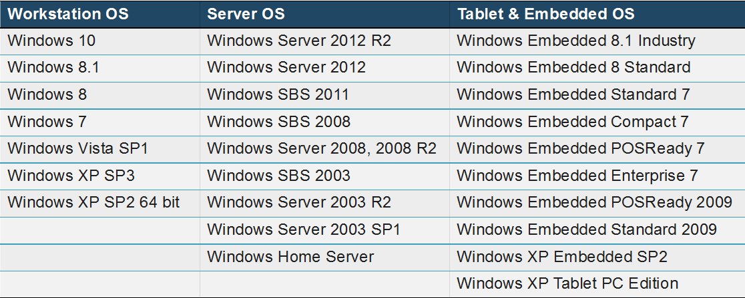
WINDOWS ENDPOINT PROTECTION
Bitdefender Endpoint Security Tools for Windows

Slide 19
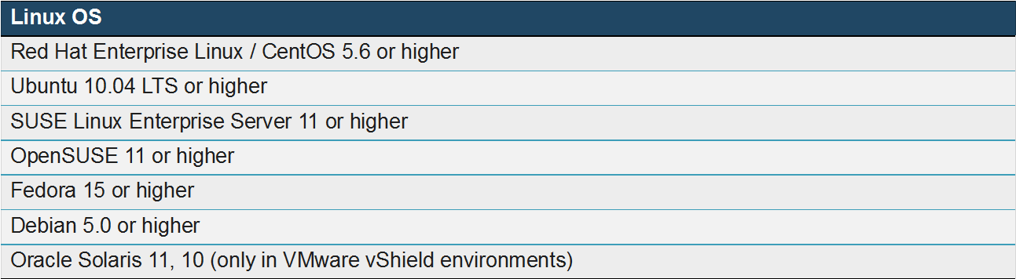
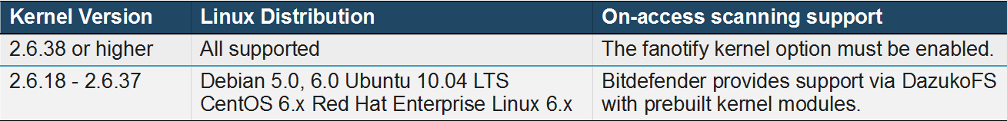
LINUX ENDPOINT PROTECTION
Bitdefender Endpoint Security Tools for Linux
On Linux systems, on-access scanning support is provided in the following situations:
Fanotify and DazukoFS enable third-party applications to control file access on Linux systems.
For any other distribution or kernel version you need to manually compile the DazukoFS module.

Slide 20
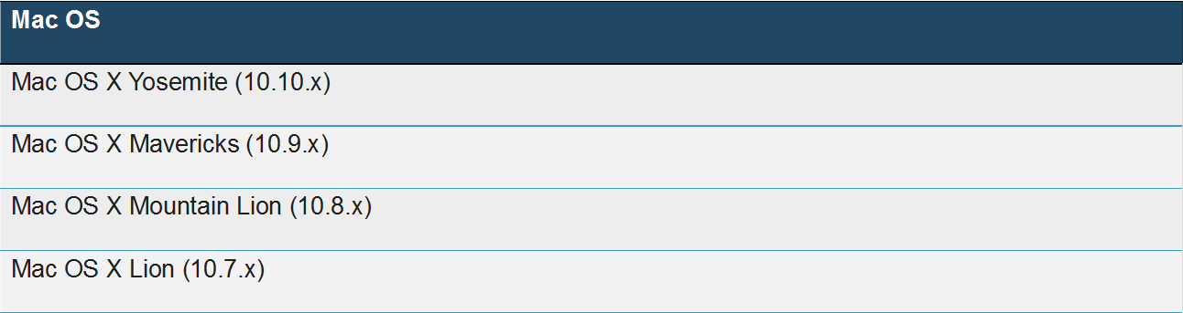
MAC ENDPOINT PROTECTION
Bitdefender Endpoint Security Tools for Mac

Slide 21






BEST: Bitdefender Endpoint Security Tools
Antimalware
Firewall
Content Control
Device Control
Power User
Notes:
Modules:
ATC
FIREWALL
CONTENT CONTROL
APPLICATION CONTROL
POWERUSER
EXCHANGEG

Slide 22





ANTIMALWARE MULTY-LAYER PROTECTION
SIGNATURES
B-HAVE
VACCINE
ATC/EXPLOITS
Notes:
Detektering af malware
Et basalt antivirus program beskytter kun mod kendte vira og slet ikke hele “paraplyen” af Malware.
De forskellige typer af Malware som vi stiftede bekendtskab med tidligere.
• Virus - program eller algoritme, som ødelægger de programmer og filer, du bruger, når du åbner dem.
• Orme - program eller algoritme, som kan kopiere sig selv og optager plads uden at være tilknyttet et specielt program.
• Spyware - samler oplysninger om dig og din adfærd.
• Adware - sender reklamer på din computer fx i pop-up vinduer.
• Trojanske heste - ødelæggende programmer som du selv downloader, fordi du tror de er gode, eller fordi de følger med et andet program.
Desuden er beskyttelsen typisk meget minimal og består blot at et signatur filter…
…maskinen er altså ikke mere beskyttet end dens sidste opdatering – hvornår var det lige I øvrigt?
En række nye tiltag er blevet udtænkt for at tage kampen op.
For sammenligningens skyld, hvorfor nøjes med at tage forbryderens fingeraftryk når man kan holde øje med hans opførelse…
SIGNATUR detektering holdes nu real-time opdateres ved hjælp af CLOUD teknologi. (Første værn)
…vil kun fange kendte vira…
2) B-HAVE (micro hyper-visor) er en slags sandbox som alle programmer åbnes I og kontrolleres inden sættes fri.
…et smart program vil skjule sine skumle intentioner så det ikke fanges…
3) ATC (advanced threat control) monitorer processer over hele dens levetid, så selv om et program skulle have kamufleret sig så klapper fælden…

Slide 23








BEST SCANNING ENGINES
NIMBUS
Security Server
Local Scan
Hybrid Scan
(Cloud Based)
Central Scan
(On Premise)

Slide 24
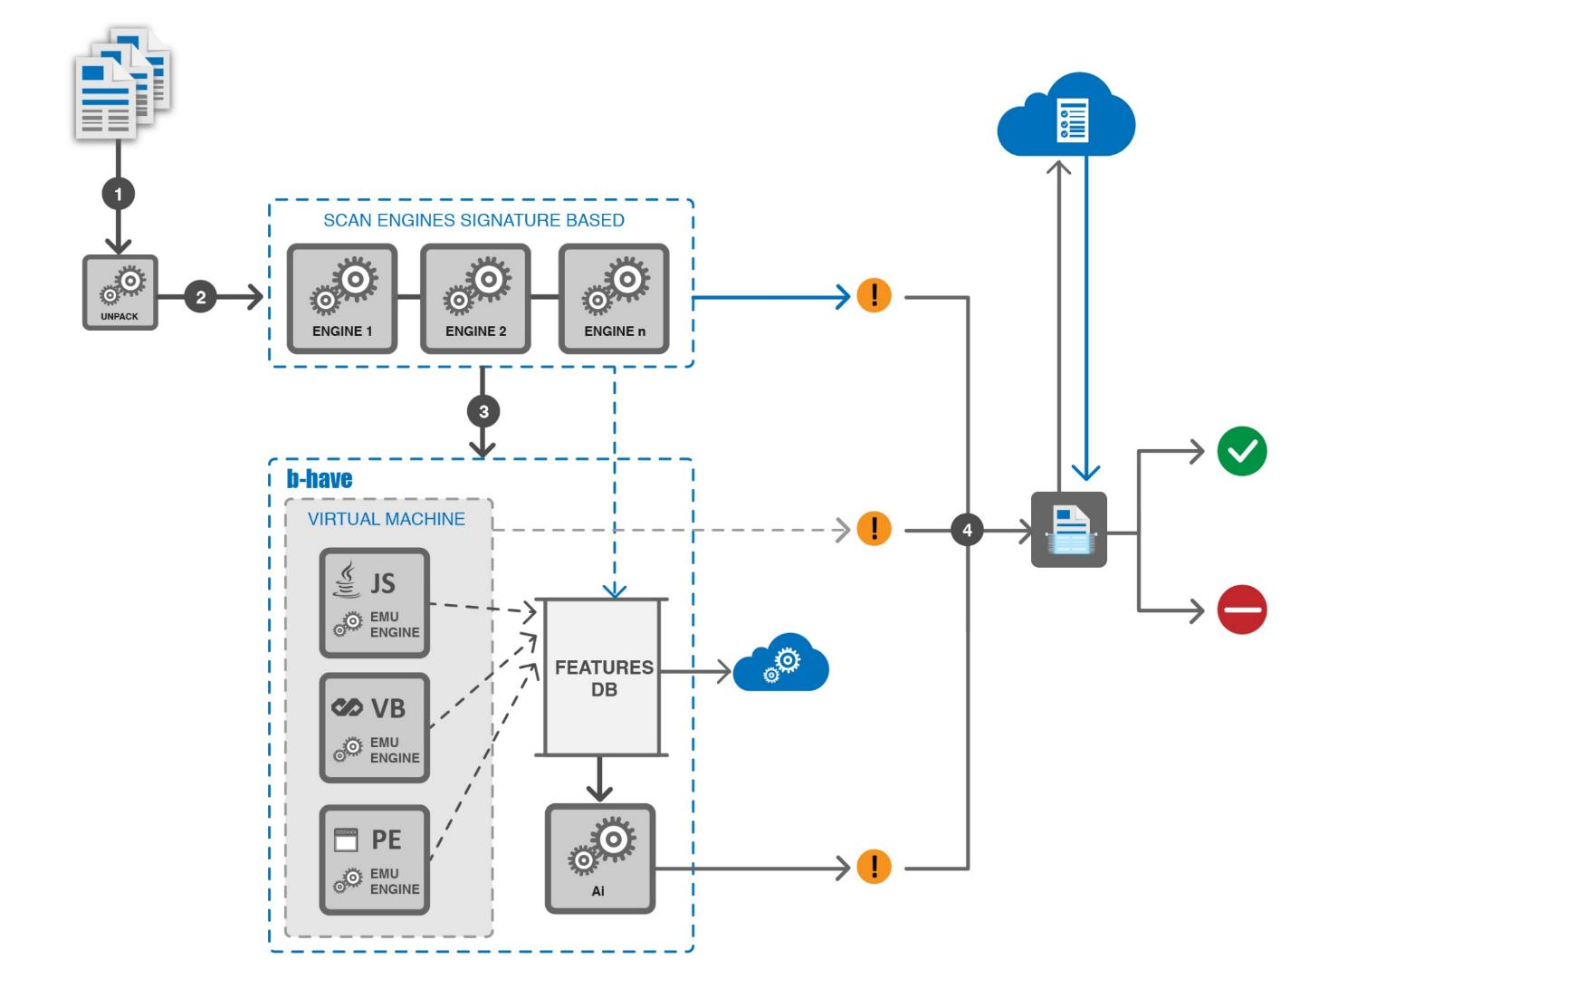
B-HAVE
Notes:
B-have
Before execution, files are emulated in a virtual machine and check for malicious behavior

Slide 25
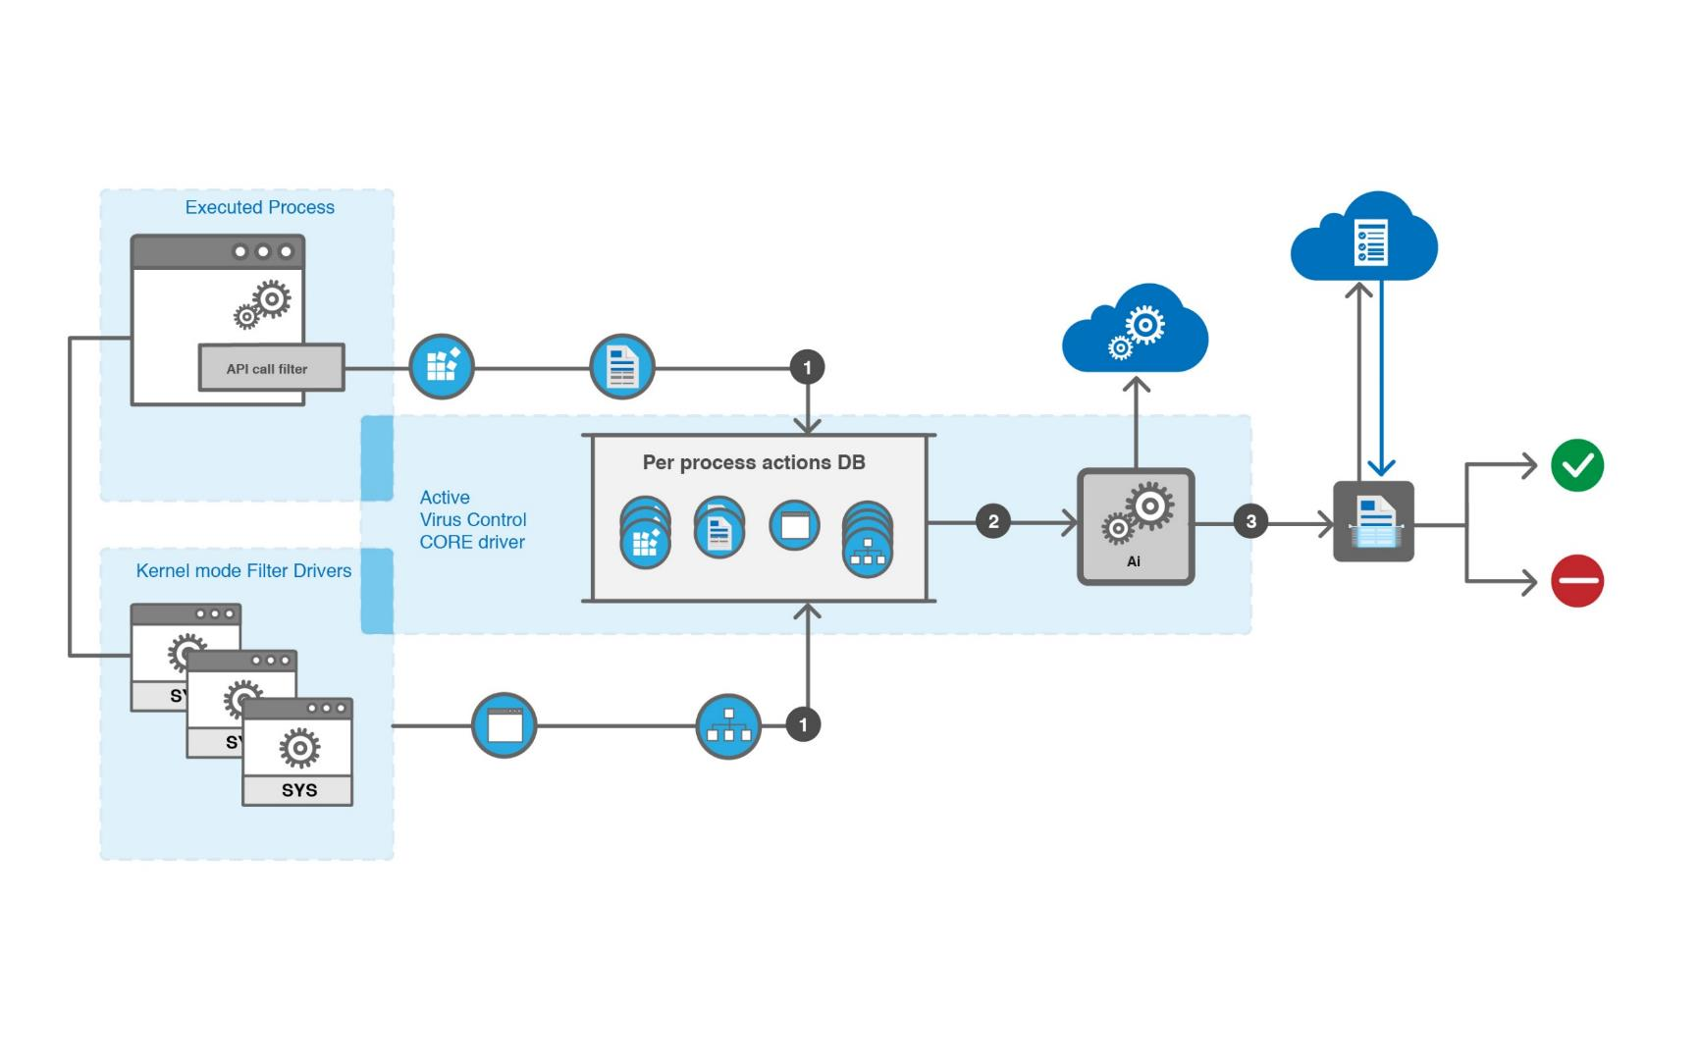
ATC
Notes:
AVC
All files and actions are monitored for the entire live-span of the mo nitored process.

Slide 26
SECURITY FOR EXCHANGE
HOW PROTECTION WORKS
Filters all Exchange email traffic – incoming, outgoing and internal, regardless of the protocol or mail client used to send emails:
Desktop clients using MAPI or POP3/SMTP (Microsoft as well as other popular mail client software)
Mobile clients using Exchange ActiveSync
Web access via Outlook Web App (OWA)
Mobile access via Outlook Web App (OWA)
Additionally, allows scanning the Exchange mailbox and public folder databases for malware, by using Exchange Web Services API from Microsoft.
Notes:
The Security for Exchange solution filters all Exchange email traffic – incoming, outgoing and internal, regardless of the protocol or mail client used to send emails. Examples of supported mail clients and protocols are listed on this slide.
Security for Exchange also allows scanning the Exchange mailbox and public folder databases for malware, by using Exchange Web Services (EWS) from Microsoft.

Slide 27









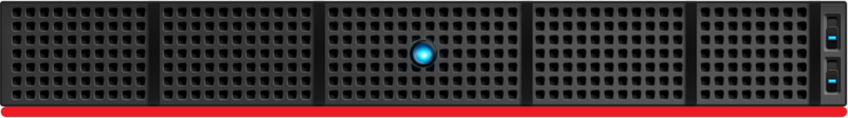
VMWARE APPROACH
vShield Manager
vCenter
GravityZone
Control Center
Security Server
Windows VM
Linux VM
vShield Endpoint Driver
vShield Host Driver
Notes:
Vmware vShield/NSX
API fra Vmware til at hjælpe med AV scanning og de tilhørende problemer…
Begrænset til Windows OS…
Gør brug af Vmware Tools agenten, så ikke “agentless”…
Kun muligt at scanne på filniveau…
Kan have sin eksistensberettigelse I komplekse netværk hvor kundersnetværk skal holdes adskilte.

Slide 28





HYPERVISOR AGNOSTIC
GravityZone
Control Center
VM
VM
VM
VM
Security Server
Notes:
Multi-Platform (Hypervisor agnostic)
Bitdefenders løsning…
Princippet er nogenlunde det same, men langt mere enkelt og tilbyder flere lag af beskyttelse…
Udover scanning på filniveau nu også memory og processor…

Slide 29
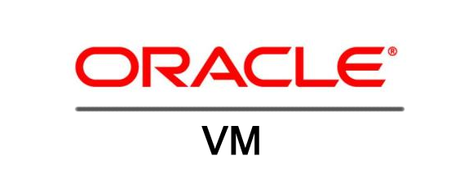




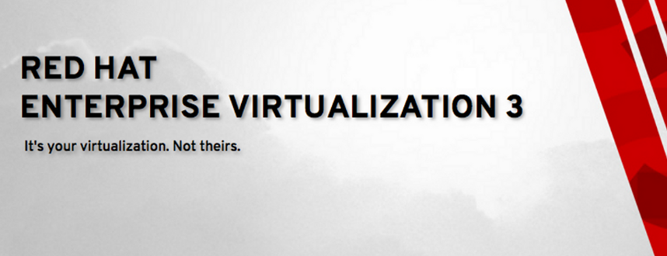
HYPERVISOR AGNOSTIC
Notes:
Multi-Platform (Hypervisor agnostic)
…lige for at slå det fast, Bitdefender kan køre på alt!

Slide 30
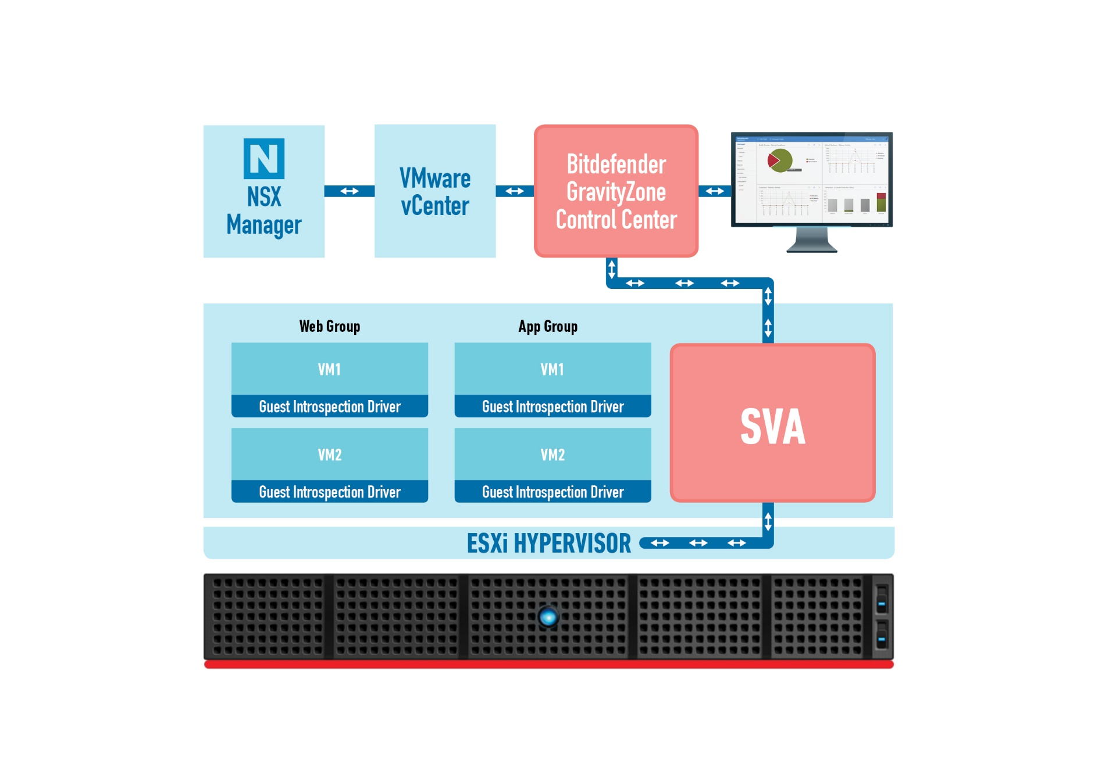

NSX INTEGRATION
Automated deployment of security to new machines in NSX groups
Security policies follow VMs wherever they are
Agentless antimalware using NSX guest introspection
Isolation and context with security from outside the VM
Automation and security boost with micro-segmentation, tagging and moving infected machines to quarantine group
Optimized Performance and consolidation ratios with Security tasks offloaded to dedicated SVA appliance

Slide 31
APPLICATION WHITELIST
BITDEFENDER

Slide 32
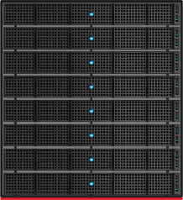



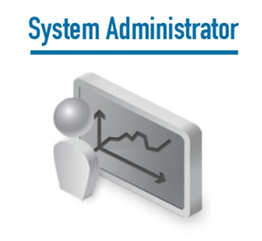
Application Control – Whitelist Architecture
BEST Agent
on Endpoints
Application Inventories
Application execution attempts
GravityZone Appliance
Whitelists configuration
Policy Settings
Application inventory management
Reports & Notifications

Slide 33
App Control / Whitelisting Features
Application Whitelisting with “Default-deny”
  “Default Deny” ensures that any application which was not pre-authorized - included in the whitelist by IT Administrator - will be denied from execution, by default.
Automatic Whitelist Updates
  Automates whitelist updates based on trust policies, including: trusted updater and trusted publisher
Test (Monitor) Mode
  Allows administrators to observe and audit whitelisting policies to ensure business needs and security considerations are achieved before enforcement actions are applied (Production Mode).
Application Inventory
  Aggregates all data collected from endpoints and provides grouping and filtering options for application policy management.
Application Event Log
  Provides powerful log analysis and reporting while delivering necessary visibility into endpoint events, including All denied application events and Test mode events.
Denied Application Policy
  Discovered applications in the Application Library can be easily added to a denied application policy and prevented from executing.
Offline Computer Protection
  Enforces whitelist on endpoints, regardless of whether or not they are connected to the network

Slide 34
APP Control Whitelisting USAGE Scenarios
Sweet spot for App Control Whitelisting
Application Control / Whitelisting is suitable for environments where security requirements are medium/high and flexibility requirements are medium/low. E.g. Critical Servers, PLC (Programmable Logic Controller) or SCADA environments, ATMs, POS, Workstations with little change like Call Center Workstations or workstations in highly regulated industries like Healthcare or Finance.
Application Control / Whitelisting implementation is more challenging in environments where high flexibility and speed of change is necessary. In scenarios where new applications are often installed (e.g. developer workstations) or high flexibility is requested (Executive’s Laptops) other controls, like Application Control / Blacklisting might be more suitable.
Critical Servers, PLC
Dynamic workstations with high security req. (e.g. Executive’s Laptops)
Security Requirements
Low High
Servers, Standard Workstations (e.g. Call Center Workstations)
Dynamic Workstations (e.g. Developer Workstations)
Low High
Flexibility Requirements
Application Control/Whitelisting is a very effective prevention layer that limits the cases of malware like ransomware, targeted attacks or zero days malware being executed on the protected endpoints.

Slide 35
HYPERVISOR INTROSPECTION (HVI)
BITDEFENDER
Notes:
GravityZone is one product with a unified management console available in the cloud, hosted by Bitdefender, or as one virtual appliance to be installed on premise, and it provides a single point for deploying, enforcing and managing security policies for any number of endpoints and of any type, in any location.

Slide 36
ADVANCED PERSISTENT THREATS: are highly sophisticated
89% of attacks have financial or espionage motivates
(Verizon, DBIR, 2016)
Target: corporations, nations, governments
Purpose: business or political espionage
Highly sophisticated, using custom-made tools and techniques
APT
Target: mid to large organizations, specific industries
Purpose: financial
Sophisticated attacks
Advanced
Targeted Attacks
5 months to discover a breach
LOW COMPLEXITY HIGH
Target: small organizations, any user
Purpose: financial
50% of breached companies need an external forensics team
Common Threats

Slide 37
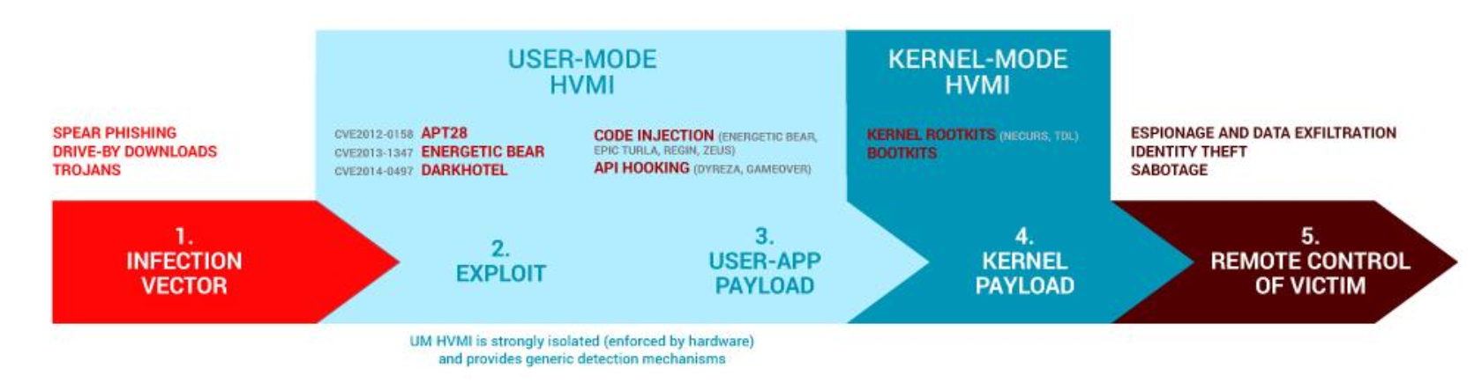
About HVI
HYPERVISOR INTROSPECTION:
A revolutionary security layer that defends enterprises against advanced targeted attacks through live memory introspection, at the hypervisor level.
Whether the protected machine is a server or a desktop, HVI provides insight at a level that is impossible to achieve from within the guest operating system. By operating at the hypervisor level and leveraging the hypervisor functionalities, HVI overcomes technical challenges of traditional security to reveal malicious activity in datacenters.
Notes:
https://www.youtube.com/watch?v=FsNcWvoe6d8

Slide 38
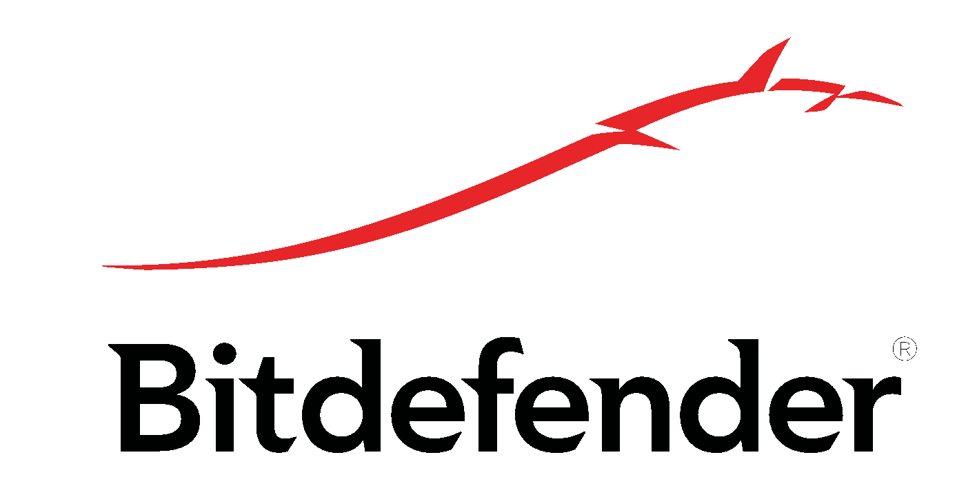





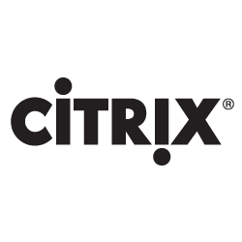
About HVI
STRONG ISOLATION (Hypervisor Controlled, Hardware Enforced)
XenServer
Control Domain (dom0)
HVI
Security Virtual Appliance
Guest
Guest
Guest
Guest
Guest
Benefits:
  Detection of malware and zero-day rootkits
  Agentless protection with zero footprint for VMs
  New layer of security, HVI being able to enforce integrry of the traditional antimalware solutions installed on the machines.
Features:
  Integration with Citrix Server
  Fast and easy deployment
  Security Policies for a two level of protection:
    Kernel Space
    Users Space
Critical Memory Access
Critical Memory Access
Critical Memory Access
Critical Memory Access
Critical Memory Access
Memory Introspection Engine
XenServer 7 Hypervisor
Citrix Direct Inspect API
Compute
Networking
Storage

Slide 39
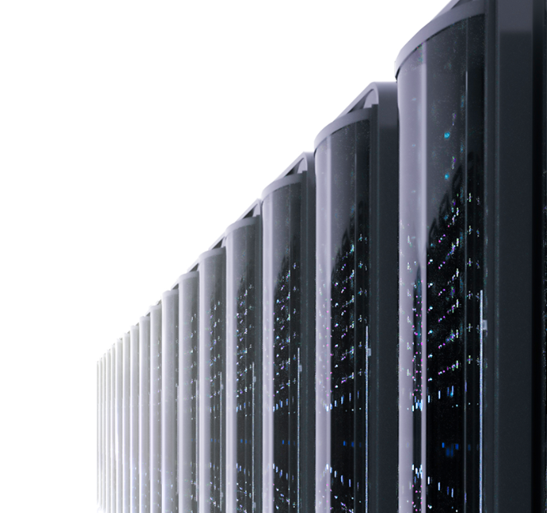
Hypervisor Introspection
A revolutionary security layer
Eliminate Security Blind Spots
Isolated and impossible to compromise
Unprecedented insight into zero-days
Already proven for several known APTs
Instantly respond to attacks
Provide detailed reporting of attack chain
Independent from and fully compatible
with any endpoint security tool
Fast Performance. Easy Management
Truly Agentless Security
Deployed from Bitdefender GravityZone Control Center
in minutes
Little to no impact on consolidation ratios

Slide 40
FAQ
Ransomware vaccine, cos’è, dov’è
definire eccezioni
porte per aggiornamenti: http 7074
porte per connessione console: https 443
porte hybrid-scan (Nimbus): http 7076
Relay: Deployer, CC Gateway, Aggiornamenti
protezione posta elettronica: Client: Content Control, Server: Exchange
disinstallare altri AV
disattivare BEST
liberare licenze
disinstallare BEST

Slide 41
Cloud Security for MSP
Key features
offerta esclusiva per i partner
pay per use (no commitment, no preventivi, no ordini)
features di Business Security + MS Exchange
nessun minimo dispositivi o mailbox per cliente
nessuna ratio client/server imposta
utilizzabile in combinazione con il licensing tradizionale
veicolo ideale per servizi a valore aggiunto variabile, dal self-service al full-managed

